Slide 1
DevOps

Slide 2
DevOps
DevOps is a combination of software development (dev) and operations (ops). It is defined as a software engineering methodology which aims to integrate the work of development teams and operations teams by facilitating a culture of collaboration and shared responsibility.
i.e., DevOps is a way of working that brings together software development (Dev) and IT operations (Ops) teams to collaborate and automate processes, leading to faster, more reliable software delivery.

Slide 3
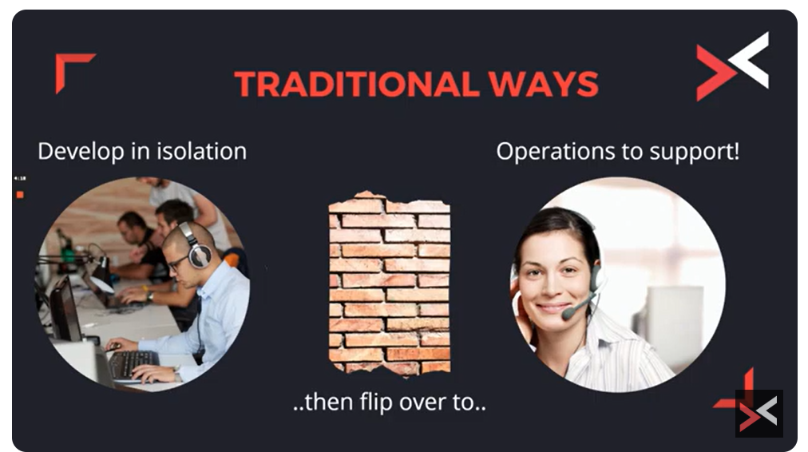

Slide 4
In software development, there has always been a gap between development and operations teams.
Developers focus on writing code and creating new features, while
Operations teams are responsible for maintaining infrastructure and ensuring software runs smoothly. This includes installing, configuring, testing, releasing, monitoring, and maintaining software products in operational environments. The goal of software operations is to ensure that applications function reliably, are available when needed, and continue to meet user requirements over time.

Slide 5
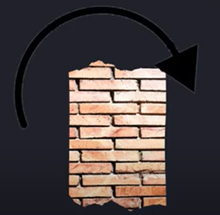
Traditional Ways
Key issues to consider
No collaboration between development and operations teams.
Sometimes operations teams may not be aware of a new application being deployed to production and therefore may struggle to support appropriately.
There may be a risk of the development team further engaged in the project even though the application is in production, due to lack of knowledge handover or missing documentations.
Lack of collaboration between development and operations teams create animosity and frustrations.

Slide 6

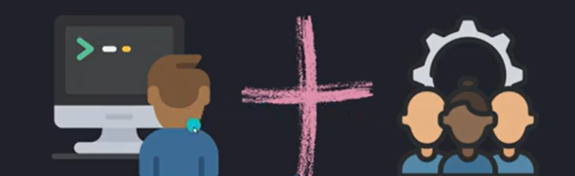
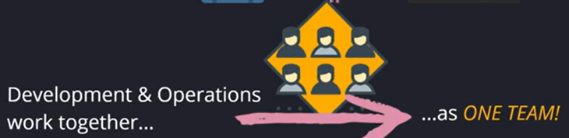
DevOps Joins Dev and Ops

Slide 7
DevOps
Here's a more detailed explanation:
Breaking Down Silos:
Traditionally, development and operations teams worked separately, which could lead to delays and misunderstandings. DevOps aims to bridge this gap by fostering collaboration and shared responsibility.
Continuous Improvement:
DevOps emphasizes continuous integration, testing, and deployment, allowing for faster feedback loops and quicker releases of new features and bug fixes.
Automation:
DevOps utilizes automation tools and processes to streamline tasks, such as code deployment, testing, and infrastructure management, reducing manual effort and errors.
Culture Shift:
DevOps is not just about tools and processes; it's also a cultural shift that promotes collaboration, transparency, and a shared focus on delivering value to customers.

Slide 8
Benefits
Faster Time to Market: By automating processes and collaborating effectively, DevOps enables organizations to deliver software faster.
Improved Quality: Continuous testing and feedback loops help ensure that software is of high quality.
Increased Reliability: Automation and robust processes contribute to more reliable software deployments and operations.
Better Customer Experience: Faster releases and higher quality software lead to a better user experience.

Slide 9
DevOps Vs Agile
Features | DevOps | Agile
Agility | Agility in both Development & Operations | Agility in only Development
Processes/ Practices | Involves processes such as CI, CD, CT, etc. | Involves practices such as Agile Scrum, Agile Kanban, etc.
Key Focus Area | Timeliness & quality have equal priority | Timeliness is the main priority
Release Cycles/ Development Sprints | Smaller release cycles with immediate feedback | Smaller release cycles
Source of Feedback | Feedback is from self (Monitoring tools) | Feedback is from customers
Scope of Work | Agility & need for Automation | Agility only
Source: https://www.edureka.co/blog/devops-vs-agile-everything-you-need-to-know/

Slide 10
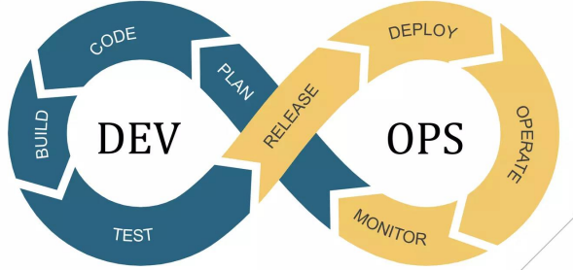
DevOps Lifecycle
&

Slide 11
DevOps Lifecycle
1. Plan (Continuous Planning & Collaboration)*
🔹 Goal: Define project scope, requirements, and objectives.
🔹 Teams collaborate to align business and technical goals.
🔹 Agile methodologies (Scrum, Kanban) are commonly used.
🔹Example Tools: Jira, Trello, Azure Boards
2. Develop (Continuous Development & Version Control)*
🔹 Goal: Write and manage code efficiently.
🔹 Developers write, review, and merge code frequently.
🔹 Version control systems help track changes.
🔹Example Tools: Git, GitHub, GitLab, Bitbucket

Slide 12
DevOps Lifecycle
3. Build (Continuous Integration - CI)*
🔹 Goal: Automate code compilation, testing, and integration.
🔹 Code is built and tested automatically after each commit.
🔹 Helps identify bugs early in the development cycle.
🔹Example Tools: Jenkins, GitLab CI/CD, CircleCI, Travis CI
4. Test (Continuous Testing & Quality Assurance)*
🔹Goal: Ensure software reliability and security.
🔹 Automated testing (unit, integration, security) is performed.
🔹 Helps detect defects before deployment.
🔹 Example Tools: Selenium, JUnit, SonarQube, OWASP ZAP

Slide 13
DevOps Lifecycle
5. Release (Continuous Deployment - CD)*
🔹 Goal: Deliver code to staging or production seamlessly.
🔹 Deployment pipelines ensure smooth, error-free releases.
🔹 Blue-green and canary deployments minimize downtime.
🔹 Example Tools: ArgoCD, Spinnaker, GitHub Actions
6. Deploy (Continuous Delivery & Automation)*
🔹 Goal: Automate deployment to production environments.
🔹 Infrastructure as Code (IaC) provisions environments.
🔹 Containerization ensures consistency across deployments.
🔹 Example Tools: Docker, Kubernetes, Terraform, Ansible

Slide 14
DevOps Lifecycle
7. Operate & Monitor (Continuous Monitoring & Feedback)*
🔹 Goal: Ensure system stability, security, and performance.
🔹 Monitoring tools provide real-time insights and alerts.
🔹 Logs and analytics help optimize system performance.
🔹 Example Tools: Prometheus, Grafana, ELK Stack, Datadog

Slide 15
Cross-Cutting Concerns
In DevOps, cross-cutting concerns are functionalities that apply across multiple modules or components, requiring careful handling to avoid code duplication and maintain system integrity.
Examples include security, logging, monitoring, etc.,.
Addressing these concerns effectively ensures efficient, secure, scalable and maintainable applications across the entire DevOps pipeline.

Slide 16
Cross-Cutting Concerns
1. Security:
Why it's a concern:
Security risks can arise at any stage of the DevOps process, from code vulnerabilities to misconfigured cloud resources.
How to address it:
DevSecOps: Integrate security practices throughout the DevOps lifecycle, not just at the end.
Automated security testing: Use tools to identify vulnerabilities early.
Security policies: Establish clear security guidelines for developers and operations teams.
Vulnerability management: Regularly scan for and remediate vulnerabilities.
Example: Implementing static code analysis and vulnerability scanning as part of the CI/CD pipeline using tools like SonarQube or Snyk to detect vulnerabilities early.

Slide 17
Cross-Cutting Concerns
2. Logging and Monitoring:
Why it's a concern:
Effective logging and monitoring are crucial for understanding system behavior, debugging issues, and ensuring performance.
How to address it:
Centralized logging: Collect logs from various components in a central location for easy analysis.
Monitoring tools: Use tools to track system performance, identify bottlenecks, and trigger alerts.
Example: Integrating log aggregation tools like ELK Stack (Elasticsearch, Logstash, Kibana) to analyze logs from different services.

Slide 18
Cross-Cutting Concerns
3. Authentication and Authorization:
Why it's a concern:
Ensuring that users have the appropriate access to resources is vital for security and data integrity.
How to address it:
Identity and Access Management (IAM): Use IAM solutions to manage user authentication and authorization.
Role-Based Access Control (RBAC): Grant users access based on their roles and responsibilities.
Example: Implementing a centralized authentication service to handle user logins and authorization across multiple applications.

Slide 19
Cross-Cutting Concerns
4. Exception Handling:
Why it's a concern:
Graceful handling of errors and exceptions is essential for maintaining application stability and user experience.
How to address it:
Robust error handling: Implement comprehensive error handling mechanisms to prevent crashes and inform users of issues.
Exception logging: Log exceptions to facilitate debugging and monitoring.
Example: Using a centralized exception handling framework that provides consistent error handling and reporting across the application.

Slide 20
Cross-Cutting Concerns
5. Scalability & Performance Optimization
Why it's a concern:
Applications should be designed to handle variable loads efficiently.
How to address it:
Example: Using Kubernetes horizontal pod autoscaling to adjust containerized workloads based on CPU or memory usage.
6. Infrastructure as Code (IaC)
Automating infrastructure provisioning ensures consistency and repeatability.
Example: Using Terraform or AWS CloudFormation to deploy cloud environments automatically.

Slide 21
Cross-Cutting Concerns
7. Compliance & Governance
Ensuring that systems meet regulatory and industry standards (e.g., GDPR, ISO 27001).
Example: Implementing policy-as-code with tools like Open Policy Agent (OPA) to enforce security and compliance rules automatically.
8. Resilience & Disaster Recovery
Ensuring business continuity through failover strategies and backups.
Example: Using Chaos Engineering tools like Gremlin to simulate failures and test system robustness.
9. Collaboration & Culture
Bridging gaps between development, operations, and security teams is necessary.
Example: Encouraging ChatOps with tools like Slack integrated with CI/CD pipelines to enable real-time collaboration.

